Slide 1
tourr: an R Package for Exploring Multivariate Data
Published By: Hadley Wickham, Dianne Cook, Heike Hofmann, and Andreas Buja (2011)
Presented By: Daniel Felbah, Yao Chen, and Gaurav Sitaula
December 11, 2017

Slide 2
Outline of Presentation
1. Introduction
2. The tour method
3. Options
4. Extending the package
5. Conclusion

Slide 3
Introduction
Toolkit of assembly of methods
Magic button
Smooth Sequence of Projections
Helpful for looking clusters, outliers, non-linear dependencies
Facilitates development of new tour methods

Slide 4
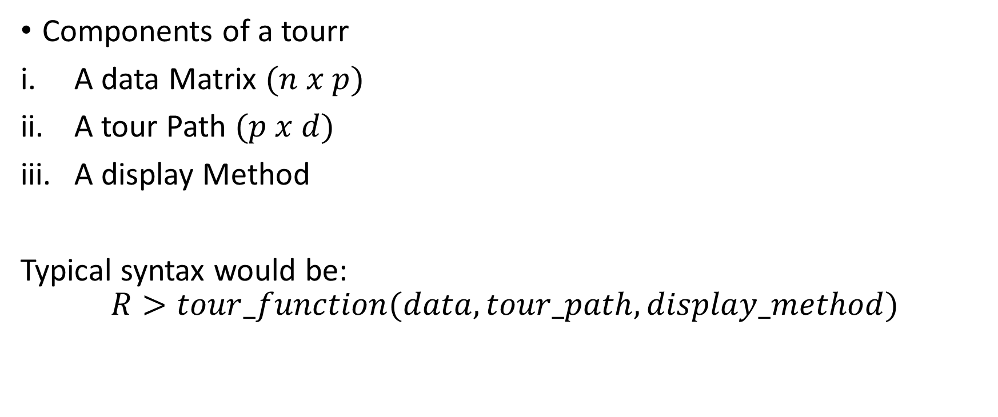
The tour Method
Components of a tourr
A data Matrix $(n x p)$
A tour Path $(p x d)$
A display Method
Typical syntax would be:
$$R>tour_function(data, tour_path, display_method)$$

Slide 5
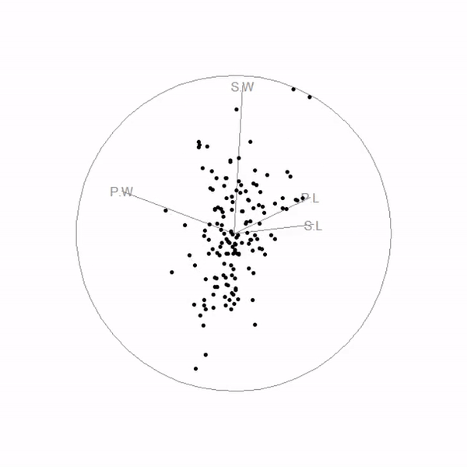
The tour Method – cont.
A 2-D tour displayed with a scatterplot

Slide 6
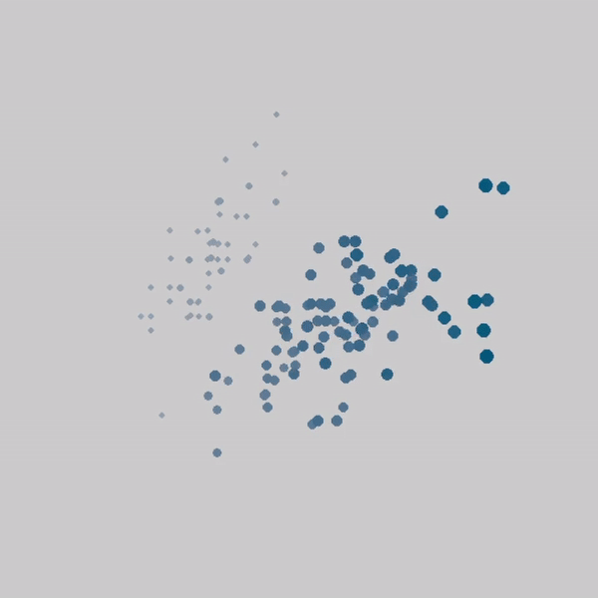
The tour Method – cont.
A 3-D tour displayed with simulated depth

Slide 7
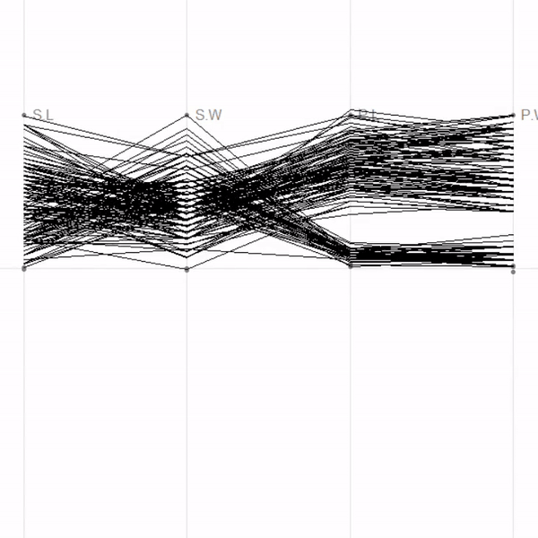
The tour Method – cont.
A 4-D tour displayed with a parallel coordinates plot

Slide 8
The Tour path
Two components;
Interpolator
Smoothly interpolates between pairs and projection
Generators
Produces the projection

Slide 9
Interpolator
Geodesic interpolation
projection of p-D data onto d (< p) dimensions
It avoids unnecessary rotation within the plane
It moves the plane, not just rotate it within itself

Slide 10
Generators
The grand_tour
The guided_tour
The planned_tour
The dependence_tour
The local_tour

Slide 11
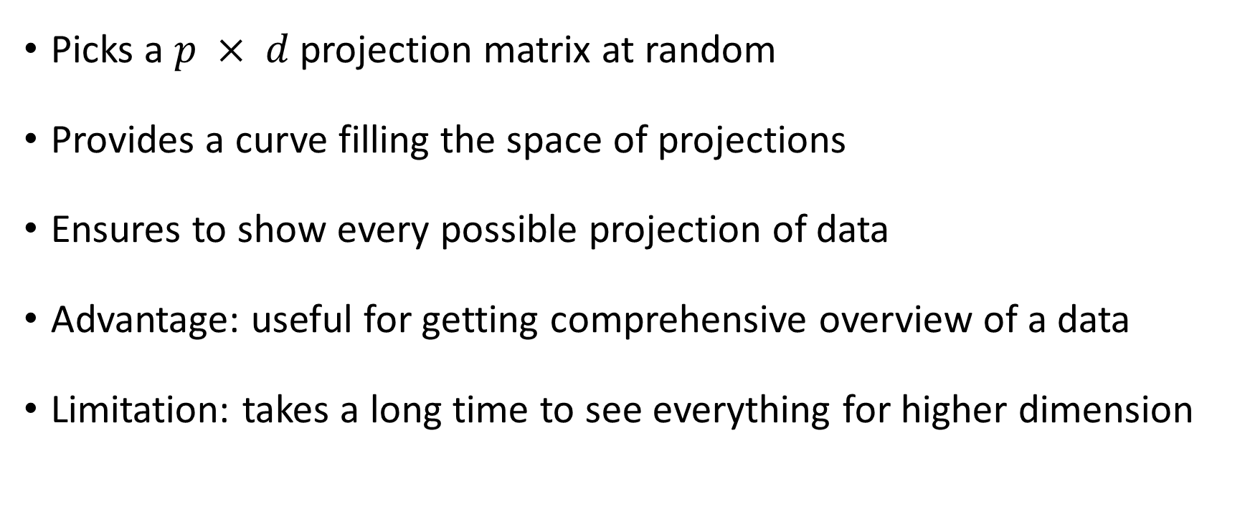
The grand_tour
Picks a $p × d$projection matrix at random
Provides a curve filling the space of projections
Ensures to show every possible projection of data
Advantage: useful for getting comprehensive overview of a data
Limitation: takes a long time to see everything for higher dimension

Slide 12
The guided_tour
Instead of random, it picks one that is “more interesting”
Dynamic form of projection pursuit
Measure of interestingness
Four Indices:
Holes (holes)
Central mass (cm)
Lda (lda_pp)
Pda (pda_pp)

Slide 13
The planned_tour:
Most constrained tour
Cycle through the pre-specified set of frames
Most useful for viewing the replay of saved tour
The dependence_tour:
Combines n independent 1-D tours
Has single argument, a numeric vector that specifies the path
The local_tour:
Alternates between a specified starting position and nearby random projections
Allows us to inspect the local neighborhood of a projection

Slide 14
Display methods
The display methods produce a visual rendering of the tour: A visualization of the projected data.
Methods classified based on the dimensionality of the projection:
1-D
– animate_dist (histogram, average shifted histogram, density plot)
– animate_image (image plot)
– animate_ts (time series)

Slide 15
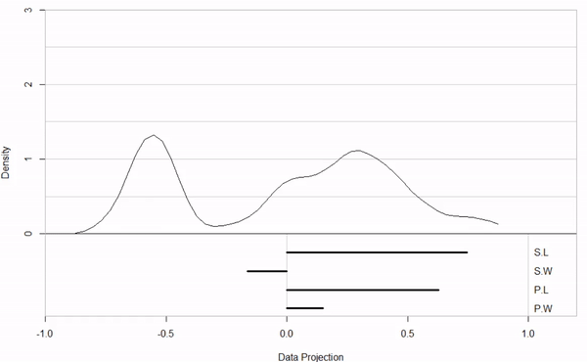
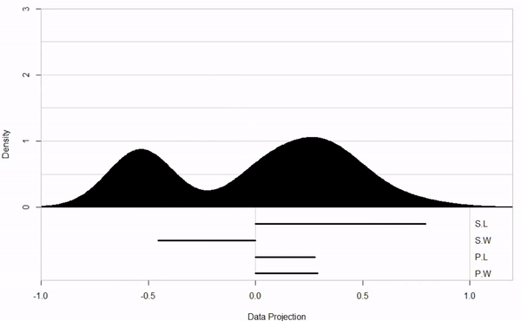
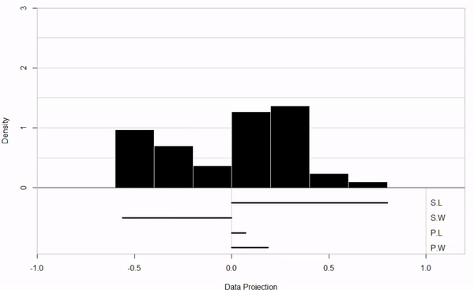
Display methods – cont.
Three visualizations of a 1-D projection

Slide 16
Display methods – cont.
2-D
– animate_xy (scatterplot)
3-D
– animate_stereo (anaglyphs)
– animate_depth (3-D depth cues)

Slide 17
Display methods – cont.
Visualization of a 2-D projection

Slide 18
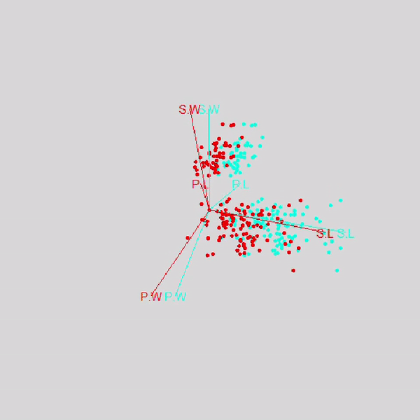
Display methods – cont.
Two visualizations of a 3-D projection

Slide 19
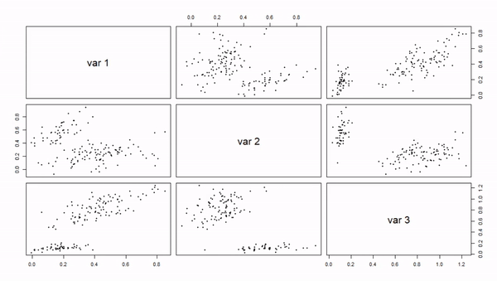
Display methods – cont.
Scatterplot matrix in a 3-D projection

Slide 20
Display methods – cont.
k-D
– animate_andrews (Andrews curves)
– animate_faces (Chernoff faces)
– animate_pcp (parallel coordinates)
– animate_scatmat (scatterplot matrix)
– animate_stars (star glyphs)

Slide 21
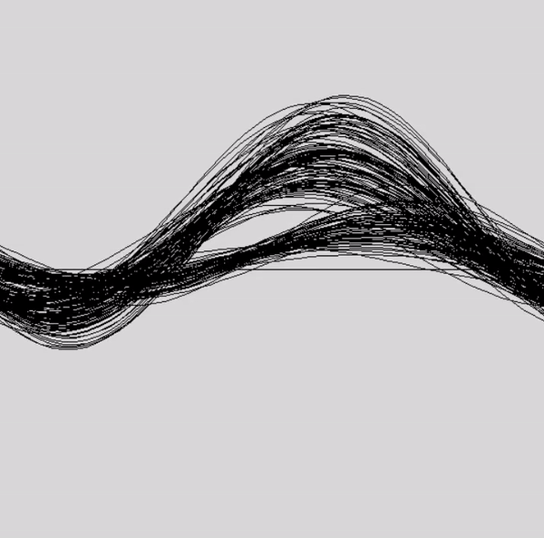
Display methods – cont.
Two visualizations of a k-D projection

Slide 22
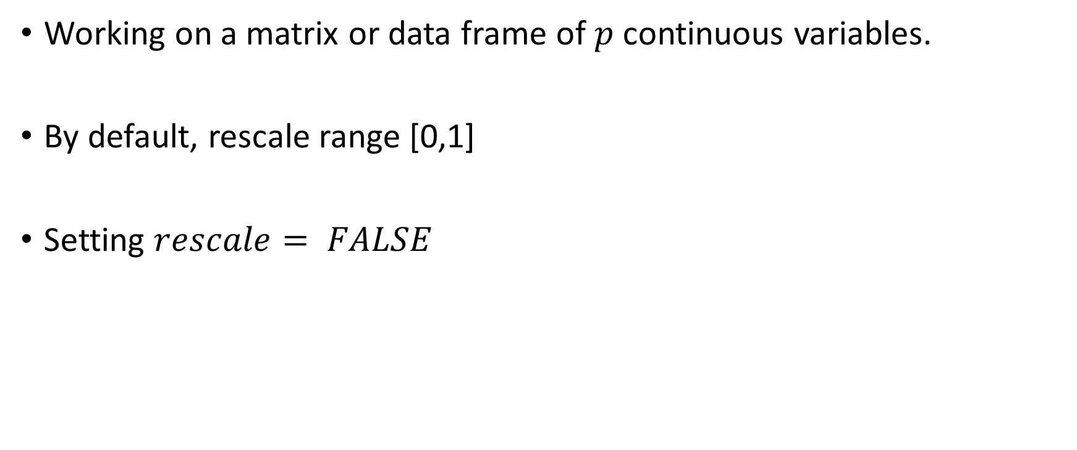
Data
Working on a matrix or data frame of $p$ continuous variables.
By default, rescale range [0,1]
Setting $rescale= FALSE$

Slide 23
Options
Frozen geodesics - Used in Xgobi
Interpolation algorithm
A matrix of frozen values, the freezer matrix
A freeze operation: zeroes out the frozen variable values in the input projection matrix.
A thaw operation: thaws the input projection matrix by replacing the 0’s of the frozen variables

Slide 24
Optimization
Purpose: Pursing an interesting projection
search_better, search_better_random: inspired by simulated annealing, these methods have been modified for better behavior in the interactive case.
search_geodesic: a new method for stochastic coordinate-wise search.

Slide 25
Optimization – cont.
Properties
1. Monotonicity: Index values for projections in the interpolation between starting and target bases increase monotonically.
2. Variable step-size:
3. Local stopping criterion: A mechanism exists that allows to jump out of a local maximum

Slide 26
History
Saving and replaying tour paths:
R> f1 <- save_history(flea[, 1:6], grand_tour(d = 1), max_bases = 10)
R> render(flea[, 1:6], planned_tour(f1), display_dist(), frames = 50,
+ "pdf", "tour1d-animation.pdf", width = 4, height = 4)
R> f1interp <- interpolate(f1)

Slide 27
Extending the package
Uses a layered design to customize the tour
Existing abstractions are used for three purposes:
To allow functions to maintain the state between subsequent calls
To create functions that meet the requirements for basis generators
To create simple “objects” to describe the different components of the display of projections

Slide 28
Closures
Closure is a function written by another function
Enclose the environment of the parent function, and can access all variables and parameters in that function
Allows us to have two level of parameters (parent and child)
This makes it possible to maintain a counter that records how many times a function has been called

Slide 29
Writing a new tour path
Consists of a basis generator and an interpolation algorithm
Geodesic interpolation
Write a basis generator for developing a new tour
Writing a new index for the guided tour
The guided tour requires a index for measuring “interestingness”

Slide 30
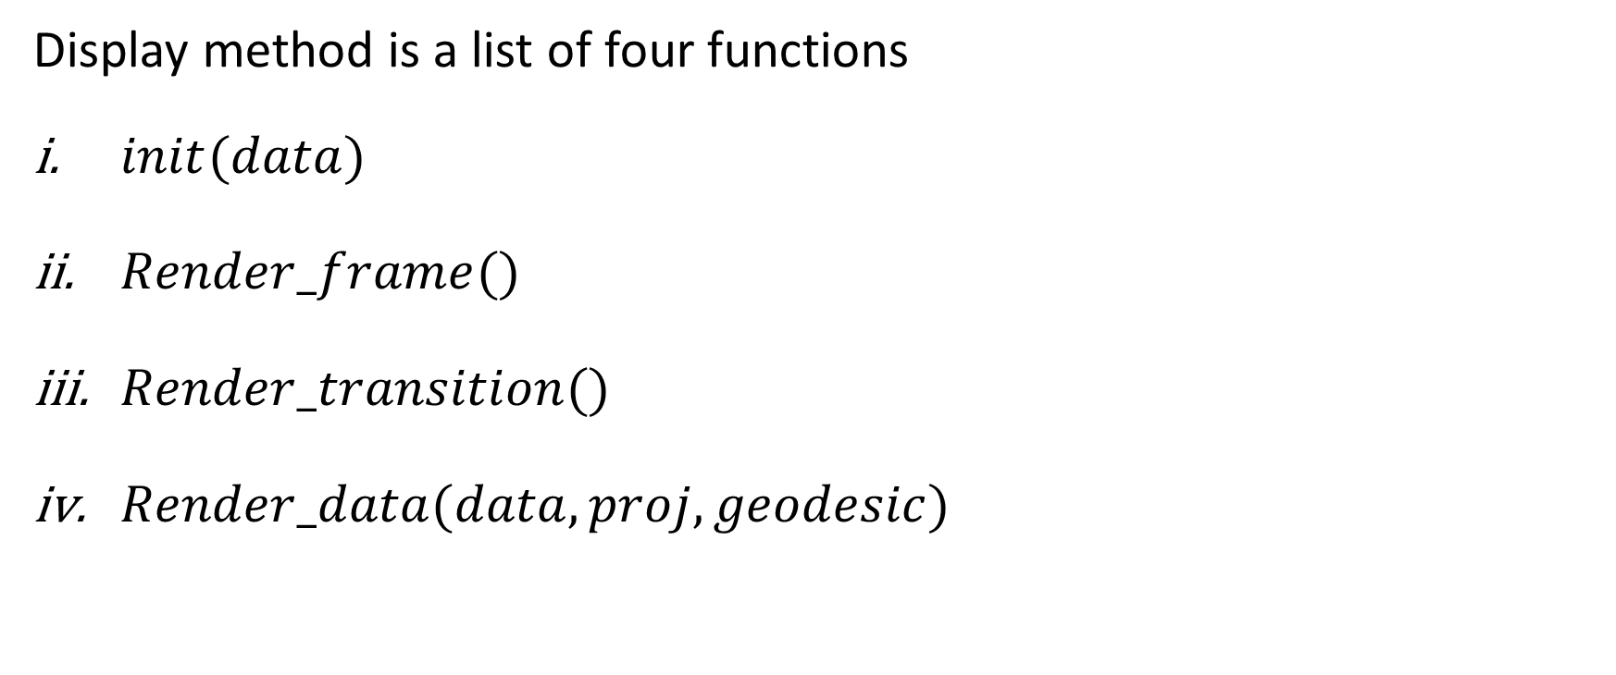
Writing a new display method
Display method is a list of four functions
$init(data)$
$Render_frame()$
$Render_transition()$
$Render_data(data, proj, geodesic)$

Slide 31
Conclusion
Really helpful for visualizing the high-dimensional data analysis
Extensions allow us to develop desired methods
Provides thrilling opportunities for further research in tour

Slide 32
References
[1] Wickham, H., et al. "tourr: An R Package for Exploring Multivariate Data with Projections."Journal of Statistical Software, vol. 40, no. 2, 2011, pp. 1-18.
[2] Swayne, Deborah F., Dianne Cook, and Andreas Buja. "XGobi: Interactive Dynamic Data Visualization in the X Window System." Journal of Computational and Graphical Statistics, vol. 7, no. 1, 1998, pp. 113-130.
[3] Fisher, R. A. (1936) The use of multiple measurements in taxonomic problems. Annals of Eugenics, 7, Part II, 179–188.

Slide 33
Thank you ☺

